Slide 1

I have to complete detailed Inventory from Scratch?!?!
Lead Presenter: Casey DeGier
I&T Department Administrative Assistant
Co-Presenter: Emily Healy
Help Desk and Systems Support Specialist
Slide Deck:
http://bit.ly/K12Inventory

Slide 2
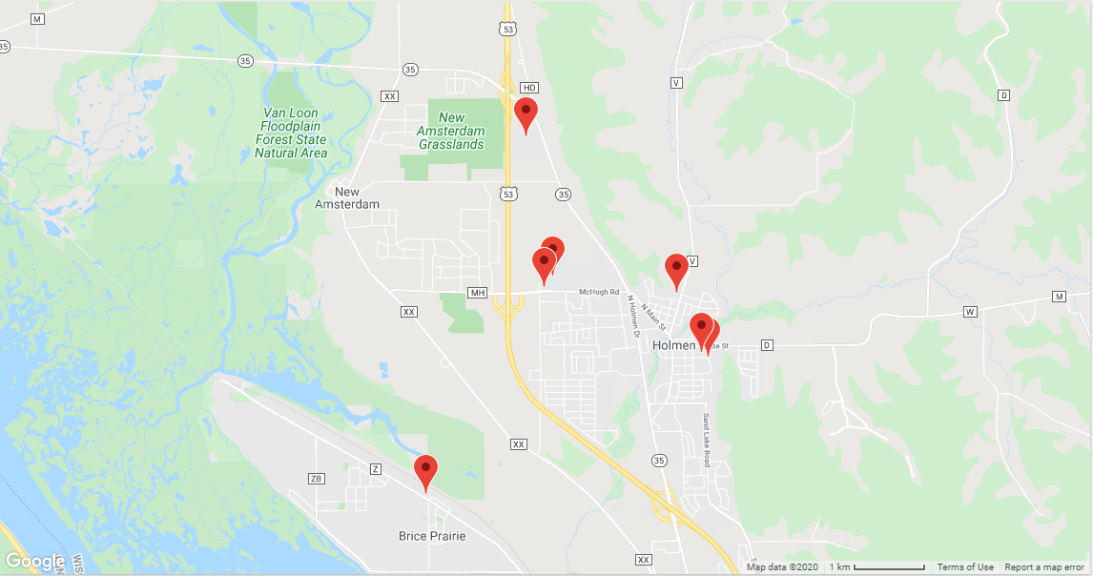
Holmen School District
4000 Students - 625 Staff Members - 9 Buildings

Slide 3
Devices
~3400 Chromebooks for Student/Staff
~450 Windows Laptops
~900 Windows Desktops
~1200 Monitors
~200 Interactive Flat Panels
  Promethean
  BenQ
  Smart
  Newline
~170 Projectors

Slide 4

Inventory System Lifecycle
Excel spreadsheet
  Pros
    Already paying for Microsoft
  Cons
    Highly outdated
    Too complex
    Unreasonable to maintain

Slide 5

Inventory System Lifecycle
Follett Destiny
  Pros
    Software utilized in LMC
  Cons
    Difficult transition
    Unreasonable to maintain
    Too many variables to include with each item
    Expensive

Slide 6
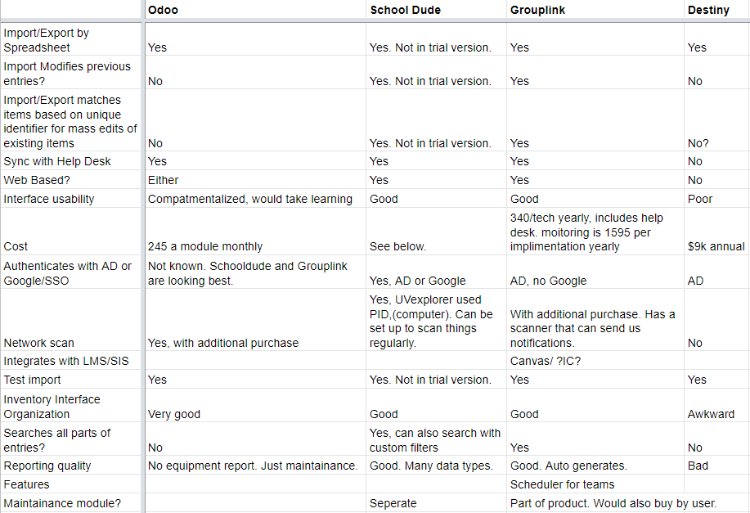
Inventory
System Lifecycle

Slide 7
What details are needed from the software?
Types of equipment to Inventory?
  Any tech device valued over $100
  Previously, anything utilized by the tech department was inventoried, including cords
What this generally encompasses, but not limited to?
  Desktop
  Laptop
  Chromebook
  Chromebook Cart
  iPad
  iPad Cart
  Doc Cam
  Projector
  IFP
  Printers
  Audio Systems
  TV

Slide 8
What details are needed from the software?
What details need to be captured?
  Manufacturer
  Model
  Asset Tag
  Location (building and room)
  Purchase Date
  Targeted Refresh Date
  Warranty

Slide 9

Inventory System Lifecycle
SCHOOLDUDE - Insight

Slide 10
Why SCHOOLDUDE?
Insight was included with our Help Desk ticketing system
One less software program to maintain
Ability to run a scan that detects wired and wireless devices over the network
Ability to import data from Google Admin Console
Ability to import data from manual templates

Slide 11

Scan Management Setup
InsightPAD
Network Devices
Windows Devices
Scan Type
Discovery Probe
IP Range Set
Credentials
Schedule

Slide 12
Scan Management
InsightPAD
  Virtual Server located within our district
  Windows 10
  SchoolDude Database Storage

Slide 13
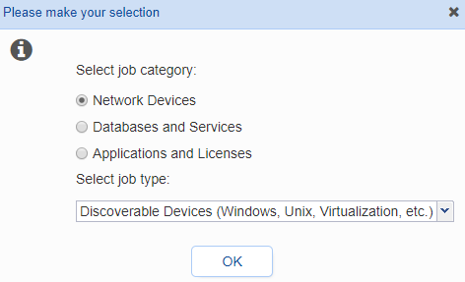
Scan Management
Network Devices

Slide 14
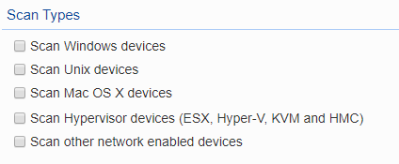
Scan Management
Scan Type

Slide 15
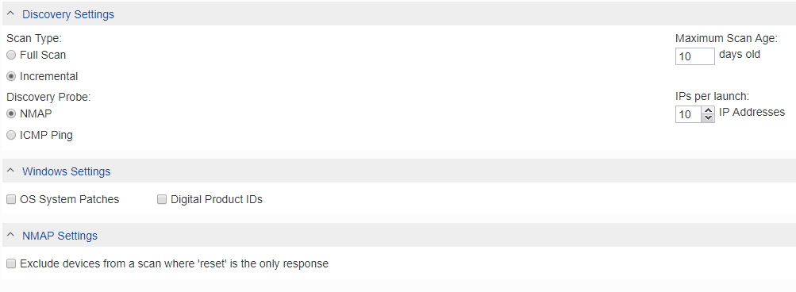
Scan Management
Discovery Probe

Slide 16
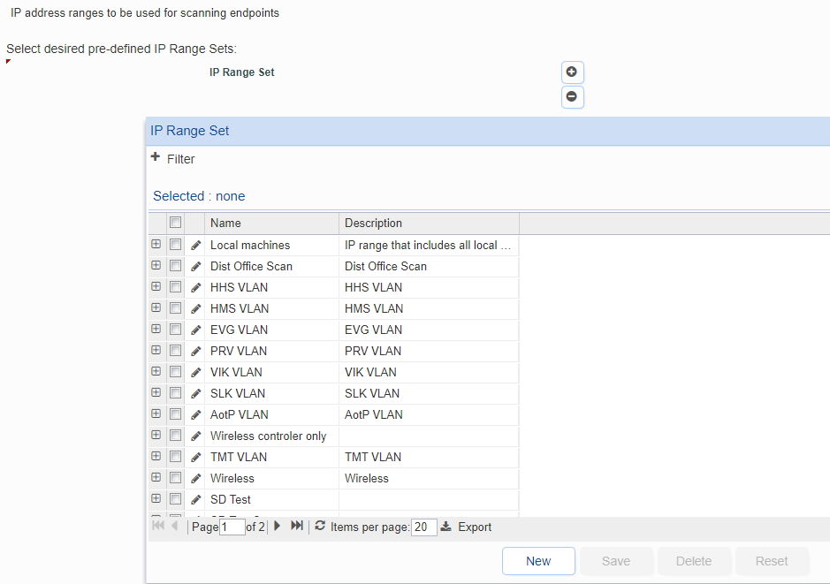
Scan Management
IP Range

Slide 17
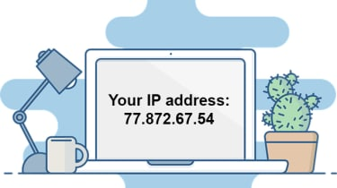
IP Range
Ranges are sorted by building
  Wired
  Wireless
When filtering can sort by specific location

Slide 18
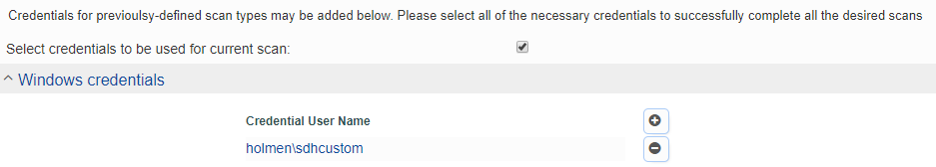
Scan Management
Credentials

Slide 19
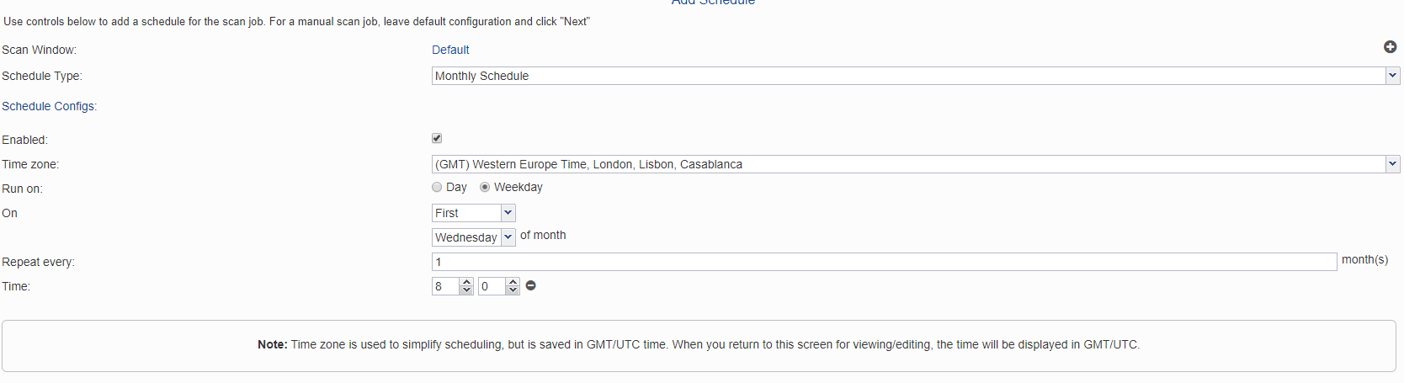
Scan Management
Schedule

Slide 20
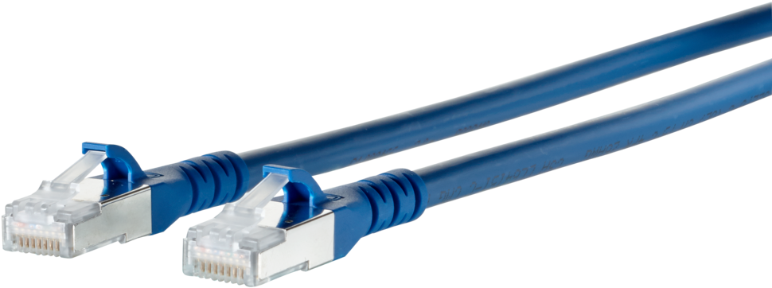

Scan Management
Schedule
Wired
  Full or Incremental
    Schedule an incremental scan monthly
    Manual full scan
Wireless
  Full or Incremental
    Manual full scan when there may be a large amount of wireless devices in a location

Slide 21


Slide 22
Chromebook
Utilizes Google Admin account to gather devices from Google Admin Console
  Pulls all chromebooks, including those that have been deprovisioned

Slide 23
Chromebook
Enroll chromebook
Automatically enrolls device into Google Admin
  Serial Number
  Status
  Asset ID
  Location
  Enrollment Time
  Last policy sync
  User
  Auto-update expiration
Manually input or import into Google Admin
  User
  Notes
Sheets Add on
  Chromebook Getter by Admin Remix

Slide 24
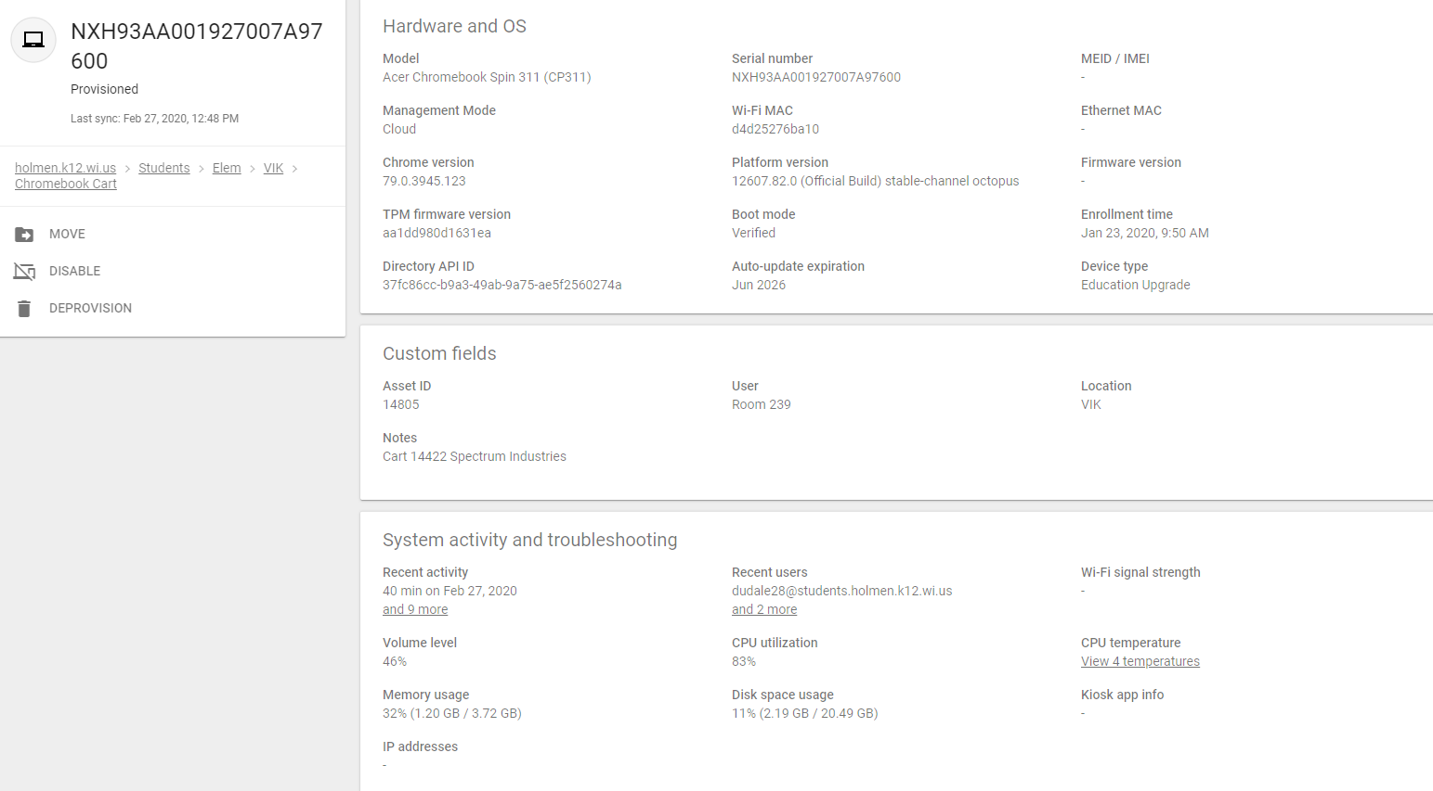
Chromebook

Slide 25
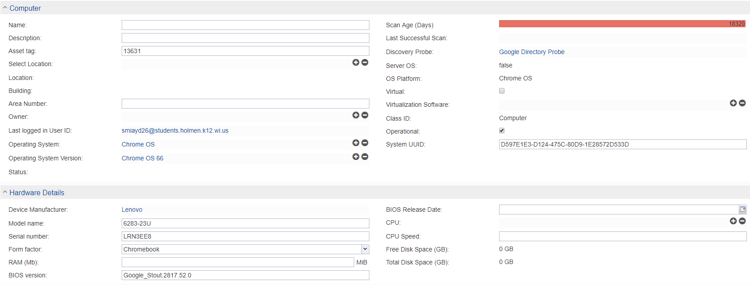
Chromebook

Slide 26

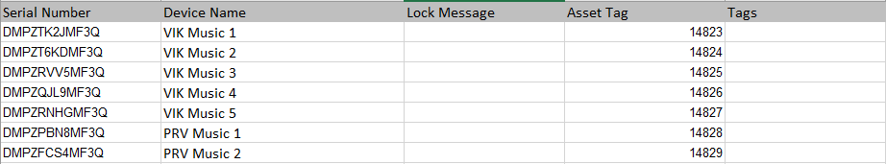
iPad
Enroll iPad
Utilize excel document to import
  Serial Number
  Asset Tag
  Device Name

Slide 27
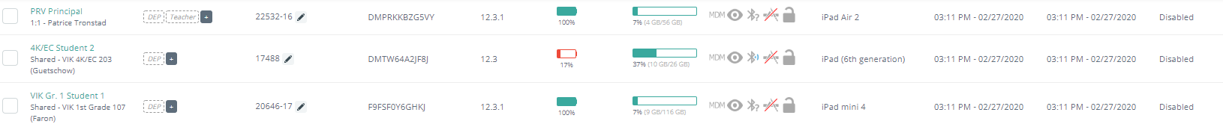
Mosyle

Slide 28
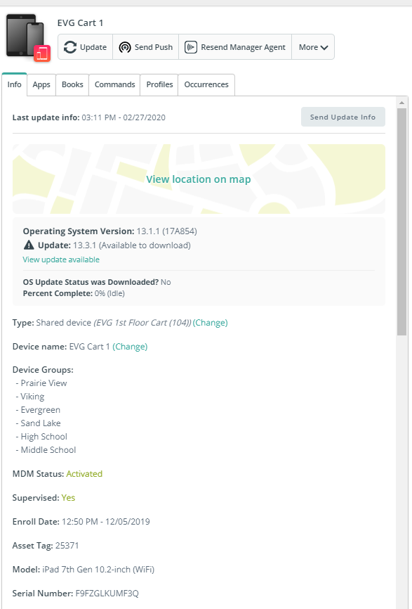
Mosyle

Slide 29
Attempts at Collecting Information
Manual walk through prior to full scan
Using paper to write down device data
Started with the largest school
Collected wired devices during the first walk through, then did a second walk through for wireless
Issues with the import templates

Slide 30
Recommended Process for Collecting Information
Complete Full Scan Setup in Scan Management for each location or IP Range
Start with the location that has the least number of devices
Ensure that all devices in this location are powered on and connected to the network
Utilize command to keep devices powered on
Run scan to identify devices in specified IP Range
  I recommend only scanning one location at a time

Slide 31
Recommended Process for Collecting Information
Sort devices in Insight
  Sorted by Device name as that is associated with our locations room number
Manually verify the serial number and asset tag of each device
  Input data into Insight
  If devices are missing, utilize the On-Demand Scan Feature after powering on the device and verifying it is connected to the network
  If devices will not scan over the network, utilize barcode scanner to gather Serial Number and Asset Tag
    Symcode Scanner

Slide 32
Recommended Process for Collecting Information
Run a full export of the specific location
  It isn’t necessary, but I’ve found it helpful to reference back to for verification purposes of retired devices
Repeat for each location or set of IP Ranges

Slide 33
Recommended Process for Collecting Wireless Information
I recommend exporting the scan from a specified location to gather the room numbers
I leave the excel sheet blank, except for room numbers
When manually verifying each wired device:
  Projector
  IFP
  Doc Cams
  TV/DVD/VCR

Slide 34
Recommended Process for Upgrading Devices
Returning to Inventory
  Monitor
    Full Export and manually add to customized Inventory category
    Run On-Demand Scan for new device
  PC
    Set Status
    Run On-Demand Scan for new device
Dispose
  Monitor
    Remove monitor from attached PC
  PC
    Set Status

Slide 35
Insight
Workstations
Monitors
Printers
Non-Discoverable Devices
Inventory By Location
Inventory By Status

Slide 36

Insight
Workstations
Consist of:
  Tower
  1+ Monitors
  Keyboard
  Mouse
Connection Types
  VGA
  HDMI
  Displayport

Slide 37
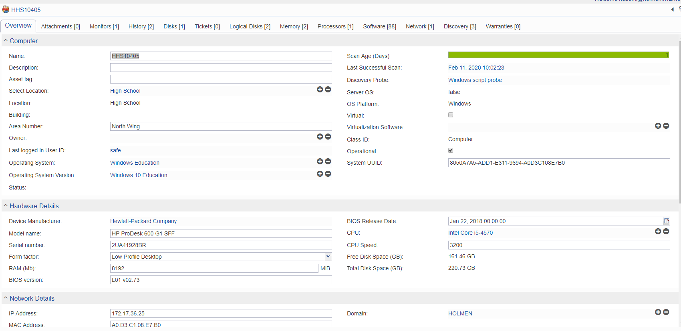
Insight
Workstation Cont.
Each Scan inventories the following:
  Model and Manufacturer
  Serial Number
  Form Factor, BIOS Version/Release date and RAM
  CPU, Speed and Disk Space
  IP Address and MAC address
  Computer Name

Slide 38


Insight
Monitors
HPs and Dells
Inconsistencies
  Not always detected
  Easily deleted
  Often needs to be manually entered
IFPs are considered monitors

Slide 39
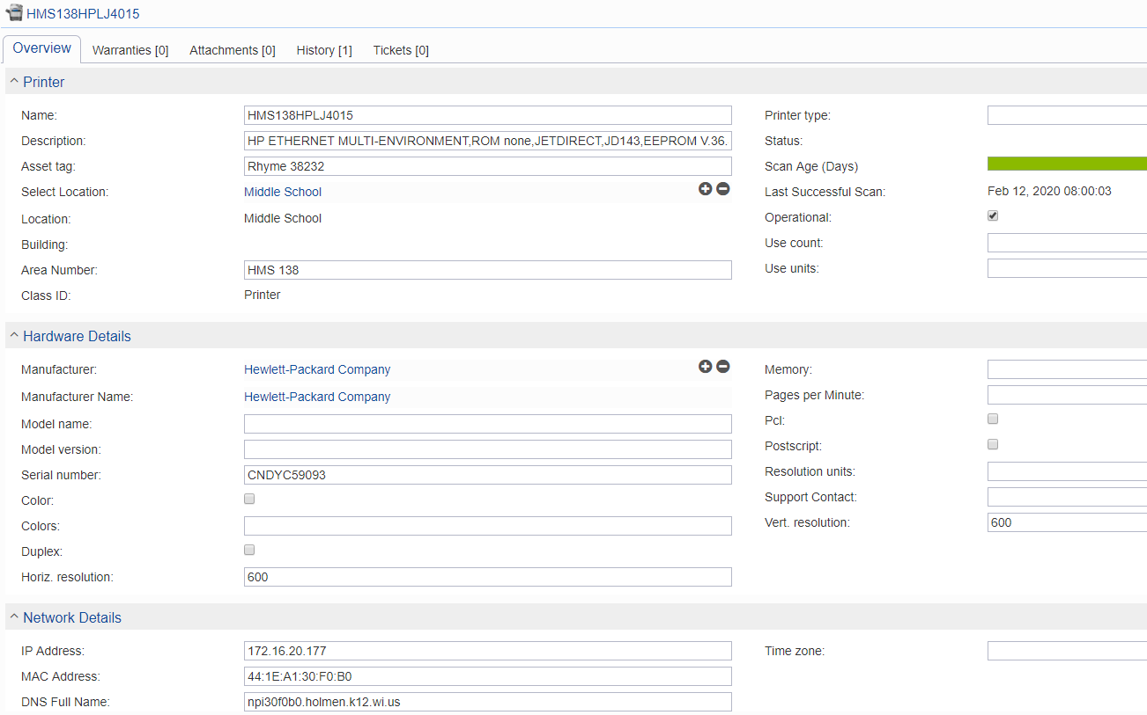
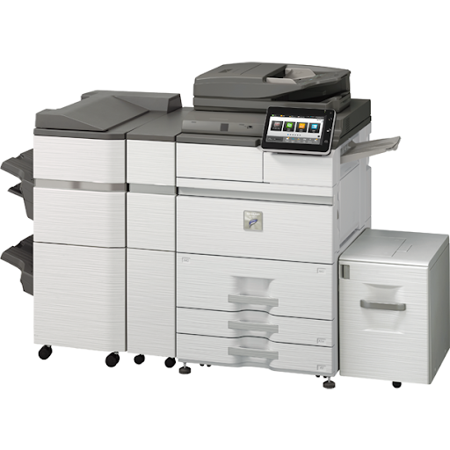
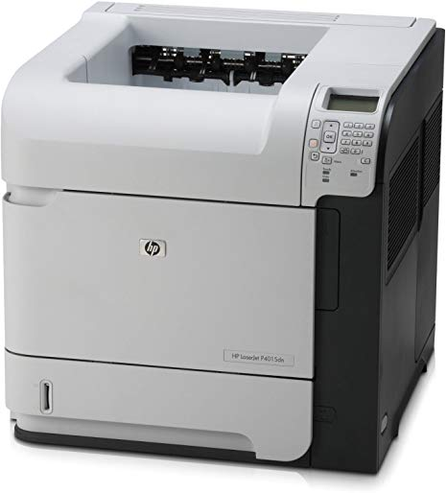
Insight
Printers/MFPs
All district printers are connected to the network
Each device is named by location and model
Asset IDs match those given by the vendor
Scan inventories the following:
  Manufacturer and Serial Number
  Location
  IP and Mac Address
All other details must be added manually

Slide 40
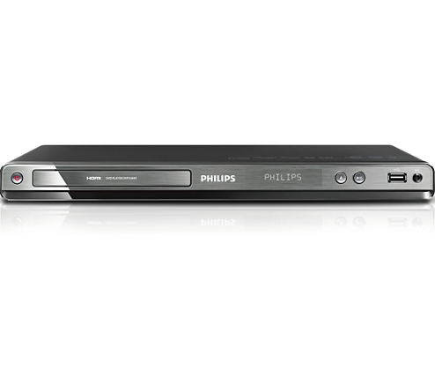

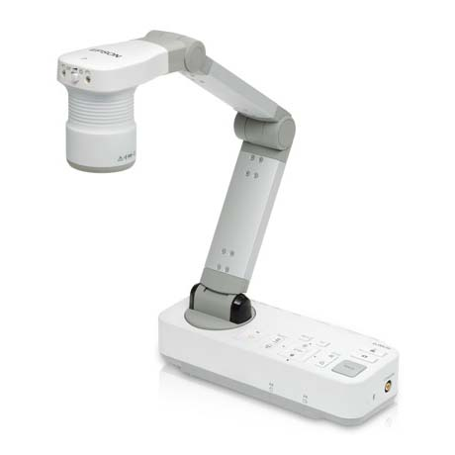
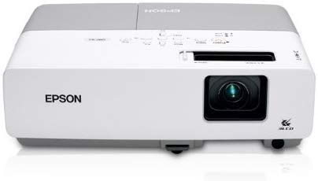
Insight
Non-Discoverable Devices
Template required for import
Customize categories
Customize type
Items Include
Smartboards (680, 800, etc.)
Doc Cams
DVD and VCR Players
Projectors

Slide 41
Insight
Inventory By Location
Offers an additional filtering system
When the IP is configured, it is categorized into a location created by the user

Slide 42
Insight
Inventory By Status
Deleted
Deployed
End of Life
In Inventory
In Repair
On Loan
Ordered
Received
Reserved
Retired
Return to Vendor
Transferred
Offers additional filtering

Slide 43
SCHOOLDUDE
Import
Import via manual inventory
A template from SCHOOLDUDE required
  SCHOOLDUDE customizes the template according to specific needs

Slide 44
SCHOOLDUDE
Export
Complete export
Filtered export

Slide 45
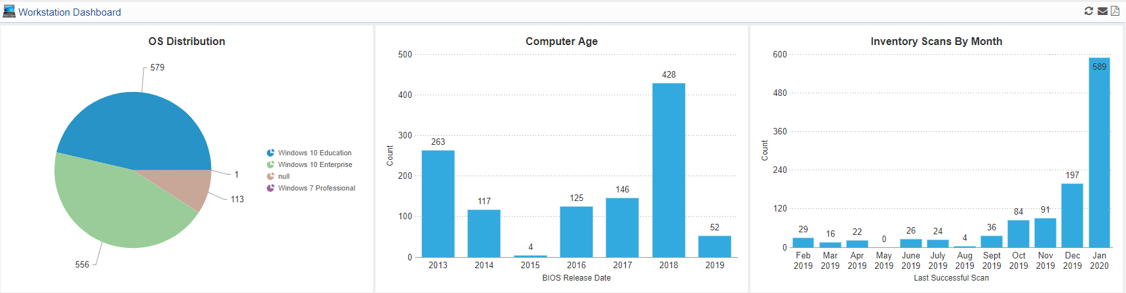
What works well?
Quick sorting
On Demand Scans
Dashboard displays containing customizable data
Import/Export
Support is strong
  Chat
  Phone
  Email
Ignores duplicates

Slide 46
What could be improved?
Complex filtering and search for a specific device
  Is, contains, between
Writes Over/Deletes monitors if they are no longer connected to a workstation
PC and Monitors don’t always come across a network scan
Manually need to remove devices when they are no longer in use
Length of time to complete a full or incremental scan

Slide 47
Continuous Problems with Maintaining Inventory
Displacement of staff
Inability to upgrade all devices at once
Dependability on others to provide updates on changes
Inconsistency with scans

Slide 48
Q & A

Slide 49
Disclaimer of Endorsement under FEDERAL TRADE COMMISSION, 16 CFR Part 255
This presentation is not an endorsement of any product manufacturer or reseller (These Entities) by the School District of Holmen. The District, its board, employees and representatives have no business affiliation with These Entities, their employees, agents or representatives. The District receives no commission or direct business benefit from These Entities for sharing this information or subsequent sales of goods/services by These Entities resulting from distribution of this information. This notification is being provided to promote awareness of goods/services that certain individuals may be interested in and/or benefit from. The District neither warrants nor represents that the claimed benefit(s) of goods/services offered by These Entities promote outcomes consistent with the District’s vision and mission. You are encouraged to, and solely responsible for, researching and determining the advantages and risks of establishing a service relationship with These Entities.

